Slide 1
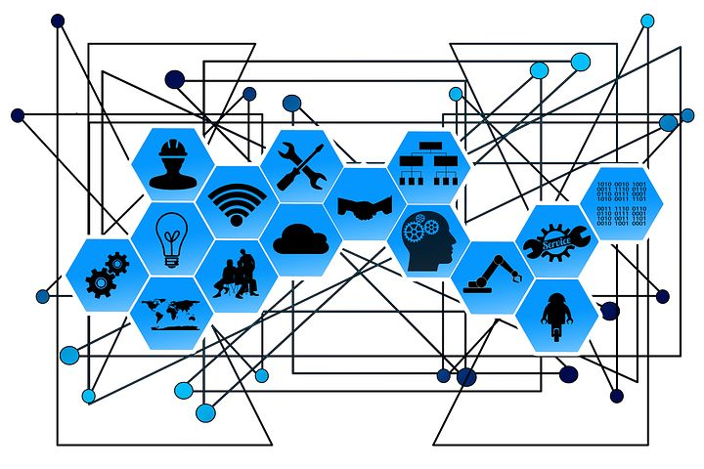
CS60055: Ubiquitous Computing
Welcome!

Slide 2
What is Ubiquitous Computing?
Let's ask it to ChatGPT …
  Ubiquitous computing, also known as pervasive computing, refers to the concept of embedding computational capabilities into everyday objects and environments to enable seamless interaction and integration with technology. This paradigm envisions a world where computers and sensors are integrated into various devices and systems, often operating invisibly and continuously in the background to enhance user experience and provide useful services.
Text generated by ChatGPT 4o

Slide 3
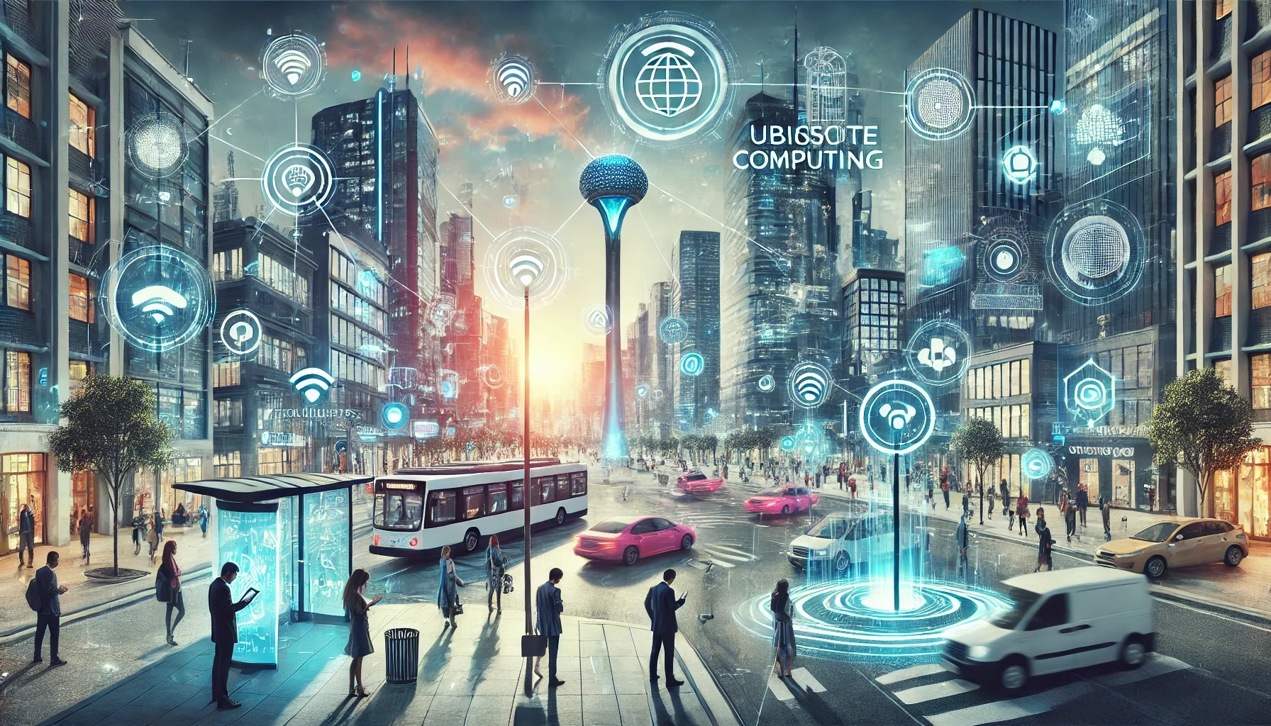
I then asked ChatGPT to generate a representation image ...
Image generated by ChatGPT 4o

Slide 4
I then asked ChatGPT to generate a representation image ...
Salient factors in this image:
Human
Sensors
Objects (static and mobile)
Connectivity
Context and Control
Interactions

Slide 5
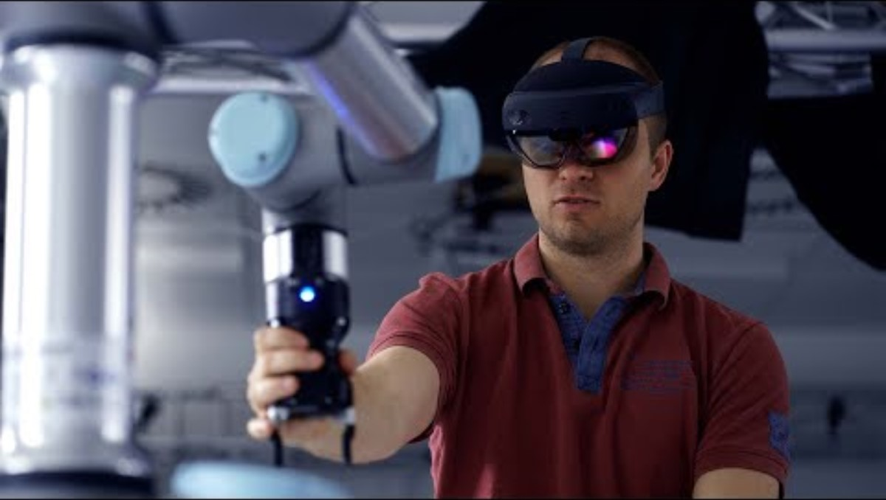
Let's see a video from a top research group on Ubiquitous Computing
Ubiquitous Computing and Interaction Group, Aarhus University, Denmark

Slide 6
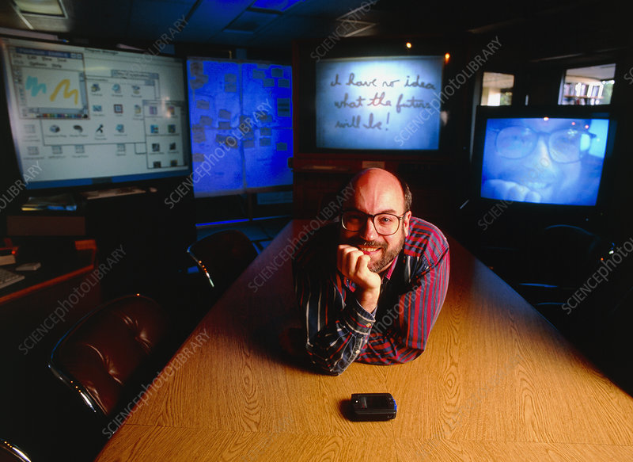
From the Father ...
"Ubiquitous computing names the third wave in computing, just now beginning. First were mainframes, each shared by lots of people. Now we are in the personal computing era, person and machine staring uneasily at each other across the desktop. Next comes ubiquitous computing, or the age of calm technology, when technology recedes into the background of our lives."
Mark Weiser, 1952 - 1999
CTO of Xerox PARC
Coined the term "Ubiquitous Computing" in 1988

Slide 7
And his article that triggered the topic "Ubiquitous Computing"
The Computer for the 21st Century
"The most profound technologies are those that disappear. They weave themselves into the fabric of everyday life until they are indistinguishable from it."
""Ubiquitous computing" in this context does not just mean computers that can be carried to the beach, jungle or airport. "
"ubiquitous computers must know where they are."
"ubiquitous computers will help overcome the problem of information overload"
Link: https://web.archive.org/web/20141022035044/http://www.ubiq.com/hypertext/weiser/SciAmDraft3.html

Slide 8
So, What Does Ubiquitous Computing Look Like?
Human
Objects
Ubiquitous Computing
Connectivity
Sensors

Slide 9
So, What Does Ubiquitous Computing Look Like?
Psychology, Physiology
Physics
Human
Objects
Ubiquitous Computing
Connectivity
Sensors
Communication
Signals and Systems

Slide 10
So, What Does Ubiquitous Computing Look Like?
Psychology, Physiology
Physics
Algorithms
Human
Objects
Ubiquitous Computing
Connectivity
Sensors
Communication
AI and Machine Learning
Signals and Systems

Slide 11

Some Interesting Ubiquitous Computing Projects
Core Idea: Picking up objects generate ubique vibration patterns
Acknowledgement: ACM SIGCHI YouTube Channel

Slide 12
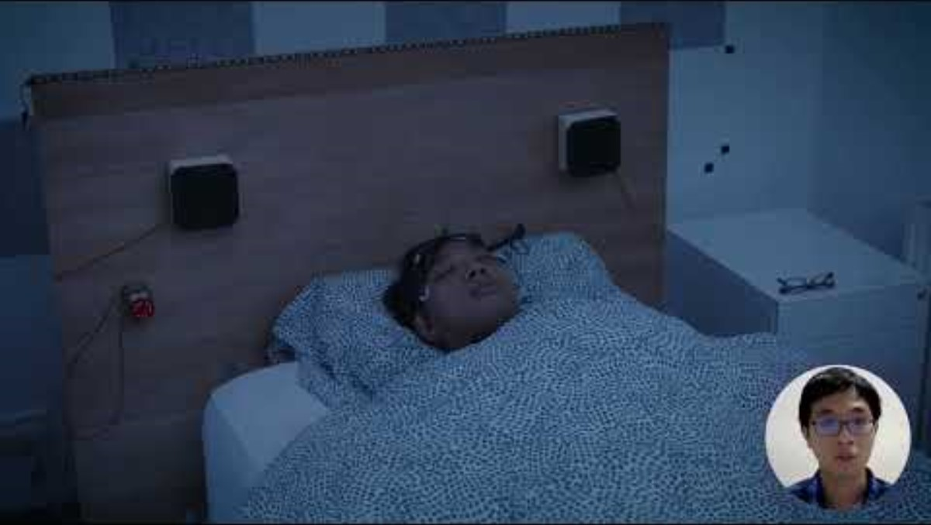
Some Interesting Ubiquitous Computing Projects
Core Idea: Room lighting and surrounding sound can stimulate lucid dreams
Acknowledgement: ACM SIGCHI YouTube Channel

Slide 13
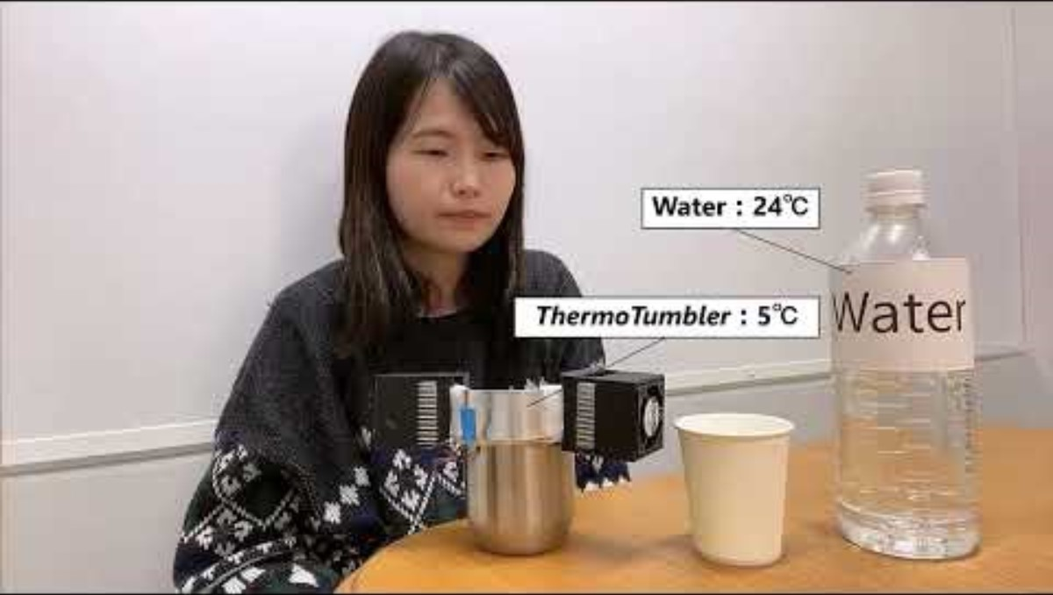
Some Interesting Ubiquitous Computing Projects
Core Idea: The temperature of the cup influences our sense of taste
Acknowledgement: ACM SIGCHI YouTube Channel

Slide 14
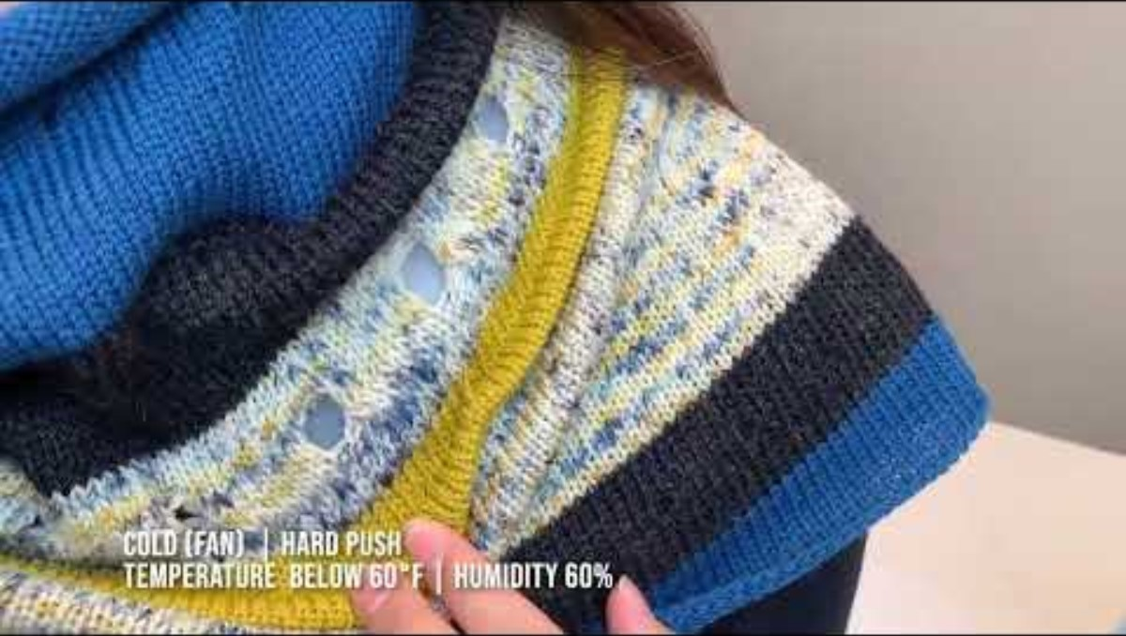
Some Interesting Ubiquitous Computing Projects
Core Idea: The right temperature and humidity levels are crucial for plants
Acknowledgement: ACM SIGCHI YouTube Channel

Slide 15
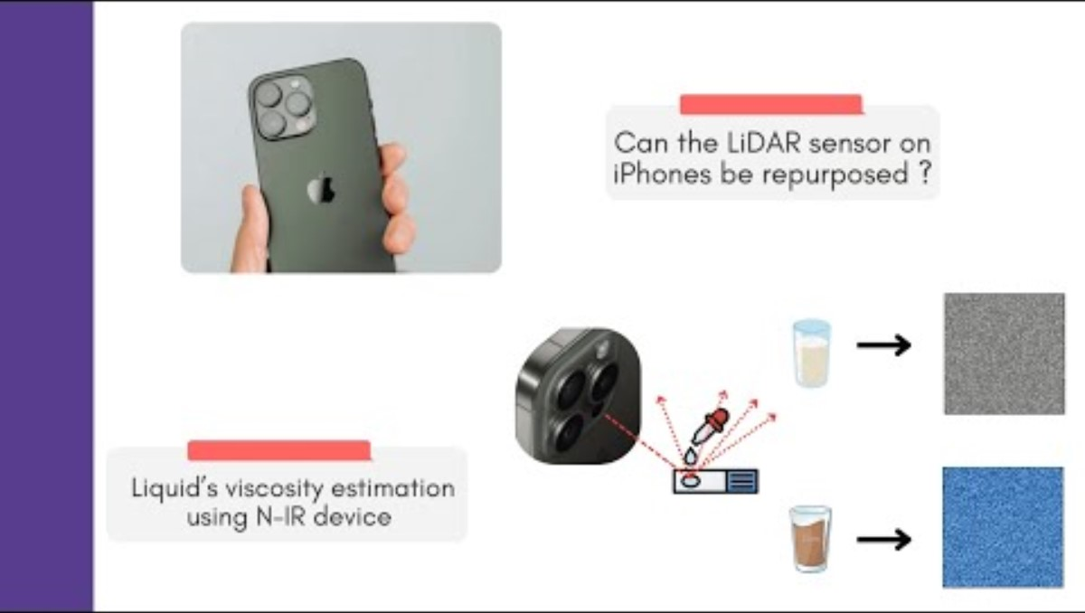
Some Interesting Ubiquitous Computing Projects
Core Idea: The viscosity of the liquid is decided by the Brownian motion of the particles

Slide 16
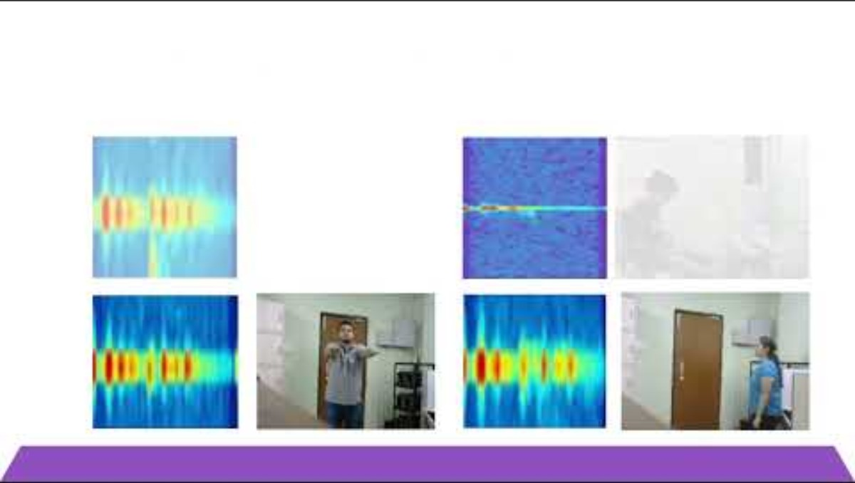
Some Interesting Ubiquitous Computing Projects
Core Idea: Human activities cause unique reflection patterns for RF signals

Slide 17
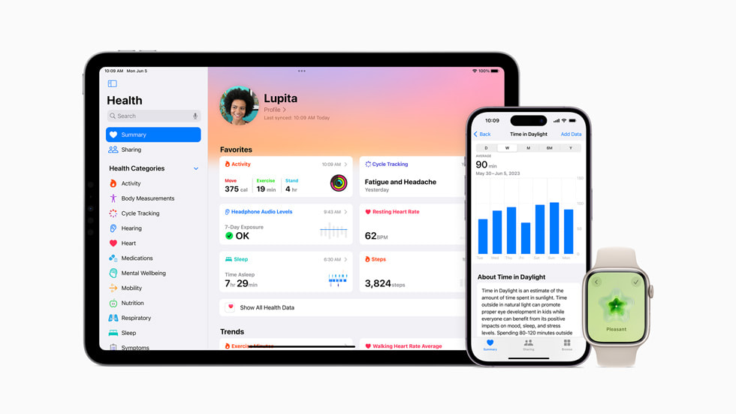

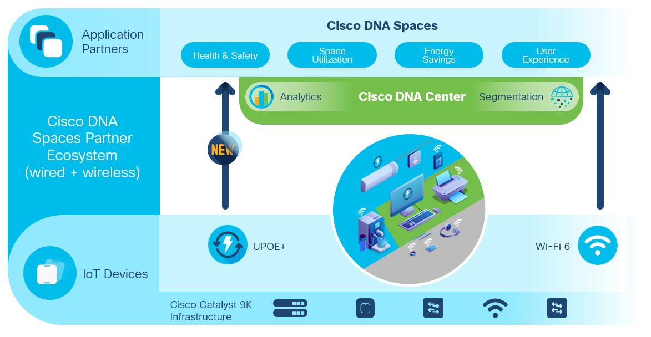

UbiComp in the Industry
There are several products that we use now a days
  Apple Health
  Google Fit
  Cisco Smart+Connected Residential
  Samsung Connected Living
  …

Slide 18
What we are going to cover
The fundamentals of physical sensing
  Sensing human: Motion, gesture and activities
  Sensing objects: Understanding the structure, materials and properties
The notion of context and contextual sensing
  What does context mean and how it impact the decisions
  Decision problems based on contextual sensing – How ML/DL can help
Interactions
  How do human and objects interact
  How can we apply logical reasoning to understand interactions
Ethics, fairness, and bias
  The privacy-accuracy tradeoff and how do we live with that

Slide 19
Class and Grading Policies
Try to attend the classes; the classroom discussions will help you to understand the topics better
  We have 5% marks for attendance
Mid and end-semester exams will carry 25% and 35% marks, respectively
Term project will carry 35% marks
  Prepare a group of three
  Check the available term projects: https://docs.google.com/spreadsheets/d/1f0PXk0M1LXl-rdplANo24gn4cGPN3WkfTd6ZbB0TcRc/edit?usp=sharing (Please do not share the list outside the class)
  Submit your choices through this Google form by 3rd August (you need to rank the projects based on your choices; the allocation will be based on FCFS): https://forms.gle/eM5duVe5Gpqh4Xv88
  You'll be informed about the allocation on 4th August
  Meet your mentor and start working upfront without delay
  Maintain a github repo to update your data, code, documents and findings. Please keep on updating the repo regularly. Share the github repo with your mentor.

Slide 20
Policy on the Use of AI Tools like ChatGPT
You can use ChatGPT (or any other AI tools) for learning purposes, understanding codes, generating code snippets, etc.
However, you must acknowledge ChatGPT (or any other AI tools that you have used) within your code snippets under comments, whenever you have generated and used the same within your implementation.
  No worries; we'll not deduct any marks for the same :-)
  However, acknowledging it is important from the ethical perspectives
Nevertheless, you should prepare the final project report yourselves. Use of any AI tools there may lead to heavy penalty. The texts in the report should not be generated through AI tools.
  You can use tools like Grammarly to check the grammars and the overall writing styles, although.

Slide 21
Ethical Issues Regarding Data Collection during the Projects
You might have to collect human data during the experiments, which might have ethical concerns
  Discuss with your mentor about the ethical considerations before you start data collection; you must follow the required ethical norms
  In your project report, you should mention about the ethical considerations and how you have addressed the same
  Whenever you have any doubt about ethical issues, please follow up with your mentor or the course instructor, immediately
We have some ethical clearances from the institute to perform the human experiments
  The term projects are mostly covered by those
  You can obtain a copy of the approval and keep it with you, in case you need to show the same during the experiments

Slide 22





Happy Learning!
Teaching Assistants
Argha Sen
arghasen10@gmail.com
Scan the QR to check the course website!
Prasenjit Karmakar
prasenjitkarmakar52282@gmail.com

